Slide 1

Web scraping to gain company insights
21/02/2023

Slide 2
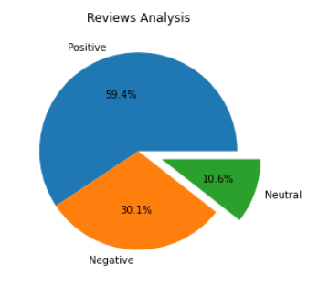
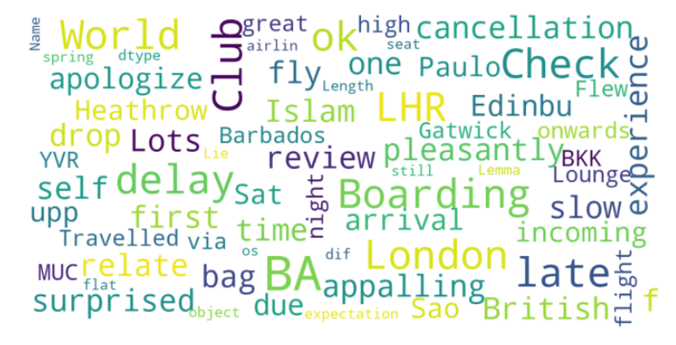
INSIGHTS FROM CUSTOMER REVIEWS
After cleaning 3400 reviews from the customers, we obtained
Positive Reviews – 2018 ---------- 59.4%
Negative Reviews – 1022 ---------- 30.1%
Neutral Reviews – 360 ---------- 10.6% Word represented Most

